Slide 1

Cloud Computing Security Using Elliptic Curve Cryptography
by
K. Yugandhar
Roll No. 224G5A3215
B. Rohini
Roll No. 214G1A3287
B. Swaroopa
Roll No. 214G1A32B1
B. Suvarchala
Roll No. 214G1A32A9
Under the guidance of
Mr. K. Venkatesh _{M. Tech.,(Ph.D)}
Assistant Professor
Department of Computer Science and Engineering (Data Science)
Srinivasa Ramanujan Institute of Technology
(Affiliated to JNTUA & Approved by AICTE) (Accredited by NAAC with ‘A’ Grade & Accredited by NBA (EEE, ECE & CSE)
Rotarypuram Village, B K Samudram Mandal, Ananthapuramu – 515701.
2024 - 2025

Slide 2
Review-0 Queries
What is ECC ?
Symmetric Encryption explanation & Which key is used ?
Why ECC is used in this project ?
What is Key Distribution Mechanism ?

Slide 3
Review-1 Queries
Brief about ECC Curves ?
How keys are generated using Curves ?
Is there any better algorithms other than ECC ?

Slide 4
Abstract
Encryption ensures secure communication over unprotected channels by preventing unauthorized access and data manipulation. Symmetric encryption, known for its large key size, is widely used for key exchange but faces challenges in cloud security due to computational overhead. However, due to large key size asymmetric encryption is mostly used for Key exchange rather than data Encryption. Nowadays, Data security is the main issue in large data centres and Cloud computing. This paper uses Elliptic Curve Cryptography with hybrid mechanism to encrypt data in the cloud environment because the size of the key used in Elliptic Curve Cryptography is very small. Due to the small key size of Elliptic Curve, computational power is reduced and this results into least energy consumption. This paper shows that elliptic curve cryptography is fast and more efficient for data protection in a cloud computing environment and reduces the computational power and also increases the efficiency.
KEYWORDS: Elliptic Curve Cryptography (ECC), Cloud Computing, Data security.

Slide 5

Contents
Planning
Requirements
Data Flow Diagram
UML Diagram
Sample Code
References
GitHub Link
Queries
Problem Statement
Objectives
Literature survey
Proposed Work
Introduction
Existing System
Proposed System

Slide 6
Problem statement
In an era of rapid digital transformation, the security of sensitive data transmitted over the internet has become a critical concern, particularly in cloud computing environments. Traditional encryption methods, while effective, often require significant computational power due to large key sizes, leading to inefficiencies in energy consumption and processing speed. As data centers continue to grow in size and complexity, there is an urgent need for a more efficient encryption method that balances strong security with minimal resource usage. This project aims to address this challenge by exploring the application of Elliptic Curve Cryptography (ECC) in cloud computing environments, focusing on its ability to provide robust data protection with reduced computational overhead and energy consumption.

Slide 7
Objective Of Project
The objective of this project is to enhance data security in cloud computing environments by implementing Elliptic Curve Cryptography (ECC).
The project aims to demonstrate ECC's ability to provide robust encryption with reduced computational power and energy consumption compared to traditional methods.
By optimizing the use of ECC for secure data transmission, this project seeks to contribute to the development of more efficient and secure cloud-based systems, ensuring the protection of sensitive information.

Slide 8
Literature Survey
S.NO | YEAR | AUTHORS | TITLE | OUTCOMES & DRAWBACKS
1 | IEEE Communications Surveys & Tutorials, 2021. | Rongxing Lu, Xingliang Yuan, and Xiaodong Lin | Encryption for Cloud Computing: An Overview | This paper offers a comprehensive overview of homomorphic encryption, a cryptographic technique that allows computations to be performed on encrypted data without requiring decryption. The paper discusses the various types of homomorphic encryption (such as fully homomorphic and partially homomorphic encryption) and their applications in cloud computing.
2 | IEEE Transactions on Services Computing, 2020 | Jian Shen, Jianwei Niu, Jiannong Cao, and Yiduo Mei, | A Survey on Cloud Security Issues and Techniques: Cryptographic and Non-Cryptographic Approaches | This survey paper explores the various security challenges in cloud computing and the solutions available to address these issues. It categorizes the solutions into cryptographic and non-cryptographic approaches.

Slide 9
Cont..
S.N0 | YEAR | AUTHORS | TITLE | OUTCOMES & DRAWBACKS
3 | IEEE Access, 2024 | Kyu-Seok Shim; Boseon Kim; Wonhyuk Lee | Research on Quantum Key, Distribution Key and Post-Quantum Cryptography Key Applied Protocols for Data Science and Web Security | This paper explores the integration of Quantum Key Distribution (QKD) and Post-Quantum Cryptography (PQC) protocols to secure data and communication systems, addressing the vulnerabilities posed by quantum computing to classical encryption methods. But PQC uses larger key sizes.
4 | IEEE Internet Of things Access, 2023 | V. S. Pendyala, S. M. Arafath, and S. R. Kulkarni, | Elliptic Curve Cryptography for Real-Time Data Encryption in IoT and Cloud Computing | The paper explores the application of Elliptic Curve Cryptography (ECC) as a highly efficient method for securing real-time data in IoT and cloud computing environments. It highlights ECC’s ability to provide strong encryption with smaller key sizes, making it particularly suitable for IoT devices with limited resources.

Slide 10
Cont..
S. NO | YEAR | AUTHORS | TITLE | OUTCOMES & DRAWBACKS
5 | IEEE 3rd International Conference on Collaboration and Internet Computing 2024 | A. Chhabra and S. Arora | An Elliptic Curve Cryptography Based Encryption Scheme for Securing the Cloud Against Eavesdropping Attacks | The proposed scheme uses ECC for key exchange and data encryption, offering high security with smaller key sizes, ensuring both confidentiality and integrity of data during storage and transmission. The paper emphasizes how ECC improves efficiency over traditional encryption methods like RSA while defending against modern security threats in the cloud.

Slide 11
Introduction
In today’s rapidly evolving digital landscape, the security of sensitive data has become a critical challenge, particularly in cloud computing environments where vast amounts of information are continuously stored and transmitted. As organizations increasingly rely on cloud services for data management, the need for robust and efficient encryption techniques is paramount.
Traditional encryption methods, such as RSA, though highly secure, often involve large key sizes, which lead to significant computational overhead and energy consumption.
Elliptic Curve Cryptography (ECC) has emerged as a highly effective alternative to traditional encryption methods. ECC offers the same level of security as other public-key cryptosystems but with much smaller key sizes. ECC's ability to provide robust security with minimal resource usage makes it an attractive option for modern data security challenges.

Slide 12
Existing System
The existing system for data security in cloud computing primarily relies on traditional encryption techniques like RSA and AES.
They often require large key sizes, leading to significant computational overhead and increased energy consumption.
This is particularly problematic in large-scale cloud environments, where efficiency and scalability are critical.

Slide 13
Proposed System
The proposed system integrates Elliptic Curve Cryptography (ECC), providing enhanced security with smaller key sizes compared to RSA, resulting in faster encryption and decryption processes.
The system includes automatic audit log updates to enhance traceability and maintain system integrity, offering a scalable, efficient, and secure cloud storage framework for optimal data security and retrieval performance.
The integration of ECC with Quantum Key Distribution (QKD) improves the scalability of cloud systems, enabling them to handle larger datasets more efficiently while maintaining robust security standards.

Slide 14
Planning
Include the stakeholders (Data Owner, Data User, Cloud) and gather their requirements.
Design the architecture, including frontend (UI), backend (server), database, cloud integration, and ECC encryption.
Develop the system in phases: authentication, file upload/download, encryption, and key management.
Implement robust authorization mechanisms to validate and control user access securely.
Ensure scalability and optimize system performance for handling multiple users and large datasets.

Slide 15
REQUIREMENTS
Requirement’s analysis is very critical process that enables the success of a system or software project to be assessed. Requirements are generally split into two types: Functional and non-functional requirements.
Functional Requirements: These are the requirements that the end user specifically demands as basic facilities that the system should offer.
Data Owner – Register, Login, Upload files, View files, View file request, Logout.
Data User - Register, Login, View files, View response, Download file, Logout.
Cloud – Login, View and authorize Data owner, View and authorize Data user, Send key, Logout.
Non-functional requirements: These are basically the quality constraints that the system must satisfy according to the project contract. The priority or extent to which these factors are implemented varies from one project to other. It includes Performance, Scalability, Security, Availability, Compatability.

Slide 16
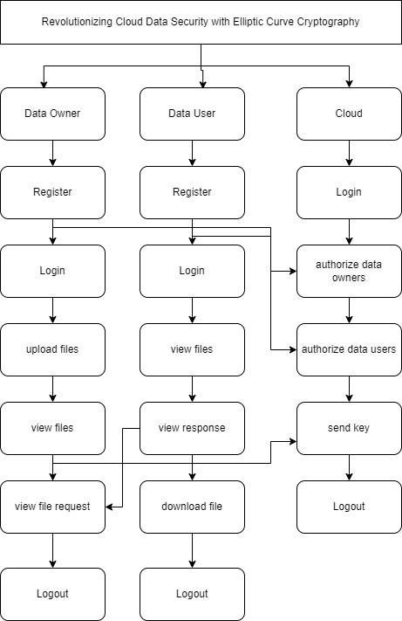
Data FlowDiagram
Figure: Working Flow of Proposed system

Slide 17
MODULES
Data Owner:
Register ,Login , upload files, view files ,viewfile request
Data User:
Register ,Login ,view files ,view response ,download file
Cloud:
Login: He can login into website by entering their credentials.
view and authorize data owners: here admin can view the registered data owners and he can authorize and unauthorize the data owners.
view and authorize data users: here admin can view the registered data users and he can authorize and unauthorize the data users.
send key: Here admin can send a key through email for downloading the file.
view file transactions: here user can view the file transactions.
Logout: All can logout after completion of their operations.

Slide 18
Methodology
Quantum Key Distribution (QKD) with ECC:
Quantum Key Distribution (QKD) is used to establish a shared secret key between two parties to securely share a cryptographic key over a potentially insecure communication channel.
Even though QKD provides a way to securely exchange cryptographic keys, the actual encryption and digital signatures still rely on classical cryptographic systems (e.g., ECC, RSA, AES). The idea is to combine the strengths of quantum mechanics (via QKD) with the security of ECC to establish and use secure cryptographic keys.

Slide 19
UML DIAGRAMS
Use Case Diagram:
A use case diagram in the Unified Modeling Language (UML) is a type of behavioral diagram defined by and created from a Use-case analysis. Its purpose is to present a graphical overview of the functionality provided by a system in terms of actors, their goals (represented as use cases), and any dependencies between those use cases. The main purpose of a use case diagram is to show what system functions are performed for which actor. Roles of the actors in the system can be depicted.

Slide 20
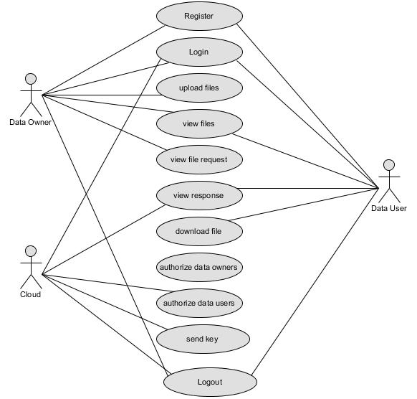
Cont...

Slide 21
Cont…
Class Diagram:
In software engineering, a class diagram in the Unified Modelling Language (UML) is a type of static structure diagram that describes the structure of a system by showing the system's classes, their attributes, operations (or methods), and the relationships among the classes. It explains which class contains information.

Slide 22
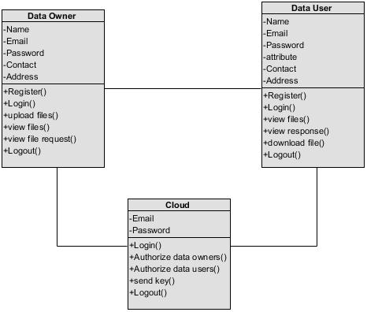
Cont.

Slide 23
Cont…
Sequence Diagram:
A sequence diagram in Unified Modelling Language (UML) is a kind of interaction diagram that shows how processes operate with one another and in what order. It is a construct of a Message Sequence Chart. Sequence diagrams are sometimes called event diagrams, event scenarios, and timing diagrams.

Slide 24
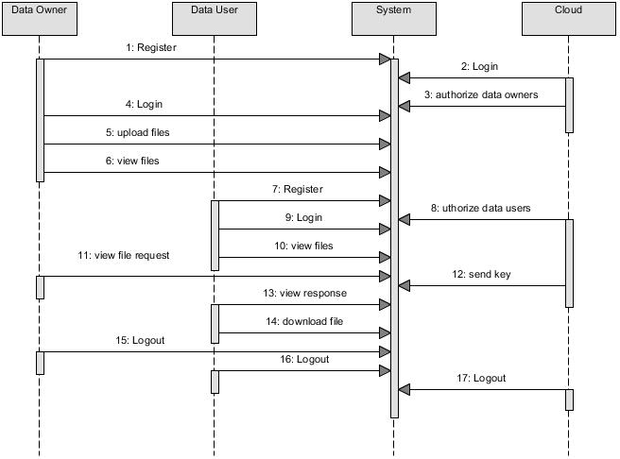
Cont…

Slide 25
Sample Code
Encryption Code :
def hybrid_encrypt(file_path, receiver_ecc_public_key):
ephemeral_private, ephemeral_public = generate_ecc_keypair()
shared_secret=ephemeral_private.privkey.secret_multiplier* receiver_ecc_public_key.pubkey.point
shared_secret_bytes= hashlib.sha256(str(shared_secret).encode()).digest() aes_key = derive_aes_key(shared_secret_bytes)
ciphertext = aes_encrypt(file_path, aes_key)

Slide 26
Cont…
Decryption code :
def hybrid_decrypt(ephemeral_public_bytes, receiver_ecc_private_key, ciphertext, output_path):
ephemeral_public=SigningKey.from_string(ephemeral_public_bytes,curve=S
ECP256k1)
shared_secret=receiver_ecc_private_key.privkey.secret_multiplier* ephemeral_public.pubkey.point
shared_secret_bytes = hashlib.sha256(str(shared_secret).encode()).digest()
pqc_shared_key = decrypt(pqc_ciphertext, pqc_private_key)
aes_decrypt(iv, ciphertext, pqc_shared_key, output_path)

Slide 27
References
[1]. R. Lu, X. Yuan, and X. Lin, "Homomorphic Encryption for Cloud Computing: An Overview," IEEE Communications Surveys & Tutorials, vol. 23, no. 4, pp. 2381-2405, 2021.
[2]. Kyu-Seok Shim; Boseon Kim; Wonhyuk Lee “Research on Quantum Key, Distribution Key and Post-Quantum Cryptography Key Applied Protocols for Data Science and Web Security “vol. 23, 2024
[3]. J. Shen, J. Niu, J. Cao, and Y. Mei, "A Survey on Cloud Security Issues and Techniques: Cryptographic and Non-Cryptographic Approaches," IEEE Transactions on Services Computing, vol. 13, no. 3, pp. 434-451, 2023.
[4]. M. S. Ali, K. K. R. Choo, and S. H. Ahmed, "Blockchain-Based Secure Data Storage and Access Control for Cloud Applications," IEEE Transactions on Cloud Computing, vol. 9, no. 3, pp. 1215-1226, 2021.
[5]. V. S. Pendyala, S. M. Arafath, and S. R. Kulkarni, "Elliptic Curve Cryptography for Real-Time Data Encryption in IoT and Cloud Computing," IEEE Internet of Things Journal, vol. 8, no. 5, pp. 3615-3623, 2021.
[6]. Dong Pan; Gui-Lu Long; Liuguo Yin; Yu-Bo Sheng; Dong Ruan; Soon Xin Ng; Jianhua Lu; Lajos Hanzo , ”The Evolution of Quantum Secure Direct Communication: On the Road to the Qinternet” Vol. 26 ,2024

Slide 28
Cont…
[7]. K. Khan and R. Qazi, "Data Security in Cloud Computing Using Elliptic Curve Cryptography," International Journal of Computing and Communication Networks, vol. 1, no. 1, pp. 46-52, 2022
[8]. V. S. Miller, "Use of Elliptic Curves in Cryptography," in Conference on the Theory and Application of Cryptographic Techniques, 2020, pp. 417-426.
[9]. M. -Q. Hong, P. -Y. Wang, and W. -B. Zhao, "Homomorphic Encryption Scheme Based on Elliptic Curve Cryptography for Privacy Protection of Cloud Computing," in IEEE 2nd International Conference on Big Data Security on Cloud (BigDataSecurity), High Performance and Smart Computing (HPSC), and Intelligent Data and Security (IDS), 2023, pp. 152-157.
[10]. A. Chhabra and S. Arora, "An Elliptic Curve Cryptography Based Encryption Scheme for Securing the Cloud Against Eavesdropping Attacks," in IEEE 3rd International Conference on Collaboration and Internet Computing (CIC), 2024, pp. 243-246.

Slide 29
Any Queries?

Slide 30
Thank You!!!

Slide 31
Data preprocessing techniques
Data Validation: Ensure files are of the correct type, size, and format before processing.
Data Cleaning: Remove unnecessary metadata, duplicates, or incomplete files to maintain data quality.
File Type Standardization: Convert files to supported formats if needed (e.g., converting DOCX to PDF).
Data Encryption Preparation: Convert files into binary or byte arrays for encryption compatibility and segment large files for efficiency.
Data Compression: Apply lossless compression methods (e.g., GZIP or Zlib) to reduce file size.
Key Generation: Generate and securely store ECC keys for encryption and decryption processes.
Data Splitting: Divide large or sensitive files into smaller parts for added security and easier handling.
Error Detection: Use checksums or hash functions to detect file corruption during upload or download.

